Slide 1

Project One
A Stocks Data Pipeline
Cecilia Cabiya

Slide 2
Outline
The stocks, etfs, and forex conversions selected for the portfolio
All investments made
The ETL process, with a code showcase
Visualizations and insights

Slide 3
Portfolio
STOCKS
ETFs
FOREX
Amazon Inc. (AMZN)
Netflix Inc. (NFLX)
Tesla Inc. (TSLA)
Brookfield Infrastructure Partners (BIP)
Vanguard Total Stock Market (VTI)
Vanguard High Dividend Yield (VYM)
United States Dollars to European Euros (EUR/USD)

Slide 4
Investments
Three investments of the same amount were made
100k invested in total, all three on January 1st, 2023
Each had different percentages for different assets
In the ‘Visualization/Insights’ section, their performance will be discussed

Slide 5
Indices
Assets can be referred back to these indices to determine their performance
Market Index used: Nasdaq 100 (NDX)
Price Index used: Nasdaq 100 Technology Sector (NDXT)

Slide 6
ETL
Data required:
Pricing information
Trading volume and transactions
Two separate indices to refer to
Additional economic indicators such as inflation

Slide 7
EXTRACT
Polygon API was index, ETF, stock, and forex data source.
TRANSFORM
Removed unnecessary columns such as replacing timestamp with date
Split Polygon’s data to fit designed table schema
Further manipulating provided data to provide functional requirement information
Cumulative, total return values
Buyer interest over time

Slide 8
LOAD
Stock Table
Forex
Table
Market/Price Indices Tables
Fact Table
Individual Stock Growth Tables
Investment Table
Market/Price Growth Tables
Date Table
Stock Volatility Table

Slide 9
Insights Before Visualization
Pulled from the assets’ prices over time tables:
TOTAL GROWTH PERCENT BETWEEN 2023-01-01 AND 2024-07-01
Amazon: 127.06%
Netflix: 126.17%
Tesla: 70.34%
VTI: 39.58%
VYM: 10.19%
Brookfield Infrastructure: -12.90%

Slide 10
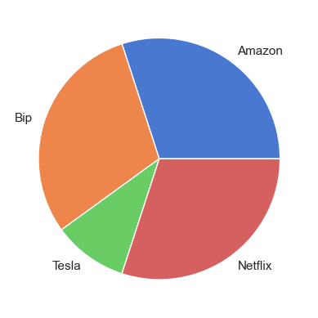
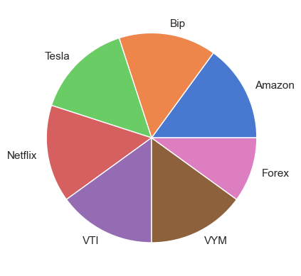
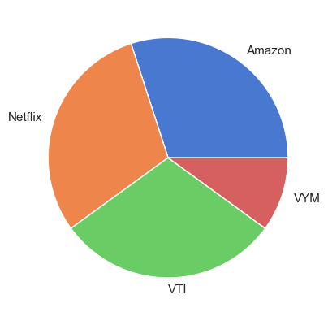
More on the 100k Investments

Slide 11
More on the 100k Investments
INVESTMENT 1
INVESTMENT 2
INVESTMENT 3
Amazon: 30k
BIP: 30k
Tesla: 10k
Netflix: 30k
VTI: 0%
VYM: 0%
Forex: 0%
Amazon: 15k
BIP: 15k
Tesla: 15k
Netflix: 15k
VTI: 15k
VYM: 15k
Forex: 10k
Amazon: 30k
BIP: 0%
Tesla: 0%
Netflix: 30k
VTI: 30k
VYM: 10k
Forex: 0%

Slide 12
More on the 100k Investments
1 RETURN: 79,133
2 RETURN: 54,066
3 RETURN: 88,862
Amazon: 38118
BIP: -3870
Tesla: 7034
Netflix: 37851
VTI: 0%
VYM: 0%
Forex: 0%
Amazon: 19059
BIP: -1935
Tesla: 10551
Netflix: 18925
VTI: 5937
VYM: 1528
Forex: 0
Amazon: 38118
BIP: 0%
Tesla: 0%
Netflix: 37851
VTI: 11874
VYM: 1019
Forex: 0%

Slide 13
Insights Before Visualization
An asset’s beta and sharpe ratio are good indicators of their volatility and benefit to buyers.
Beta displays a stock's volatility [3]
Beta > 1.0 = Stock is more volatile than market
Beta < 1.0 = Stock is less volatile than market
Sharpe ratio displays how well a stock is performing [4]
Sharpe > 2.0 = Well-performing stock
Sharpe > 3.0 = Excellent-performing stock

Slide 14
Insights Before Visualization
Pulled from the stock volatility tables:
SHARPE AND BETA VALUES
Tesla
Beta: 2.33 Sharpe: 2.0
Amazon
Beta: 1.15 Sharpe: 3.38
Netflix
Beta: 1.27 Sharpe: 3.35
VTI
Beta: 1.01 Sharpe: 3.28
VYM
Beta: .76 Sharpe: 1.16
Brookfield Infrastructure
Beta: 1.03 Sharpe: -2.44

Slide 15
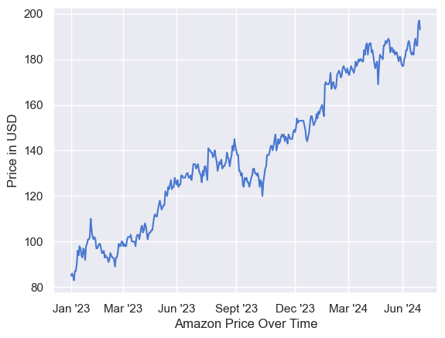
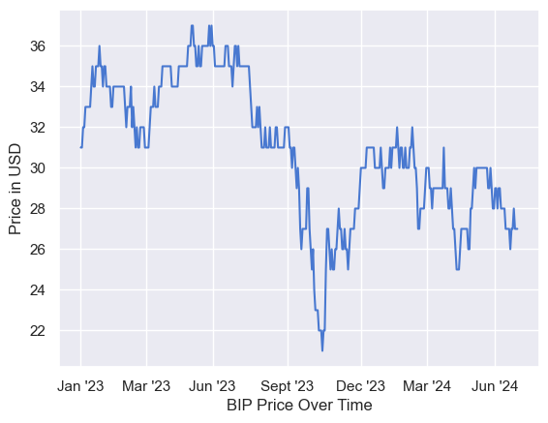
Price Visualization

Slide 16
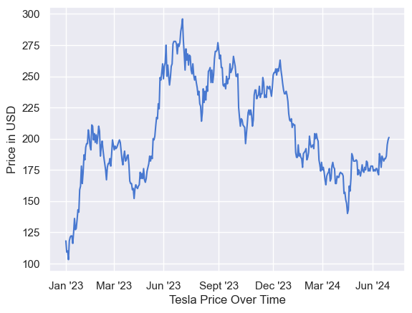
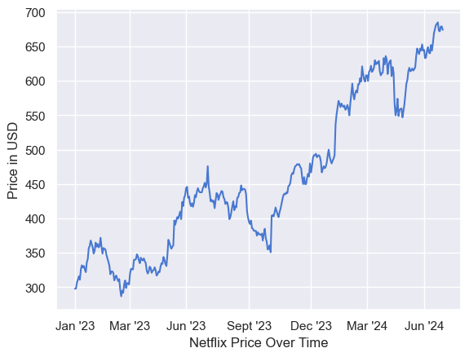
Price Visualization

Slide 17
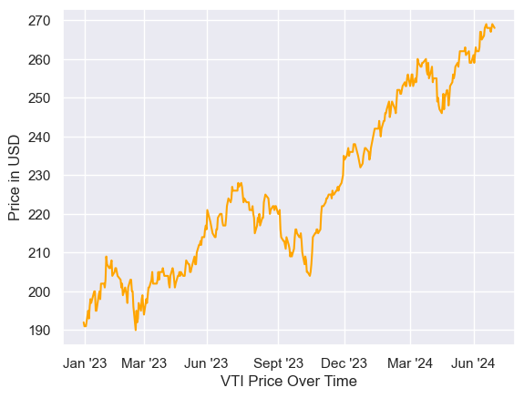
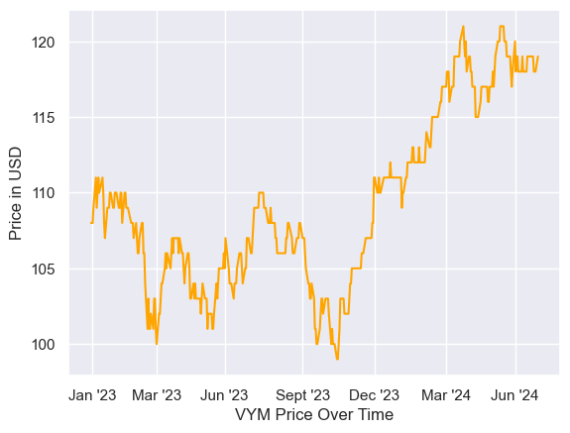
Price Visualization

Slide 18
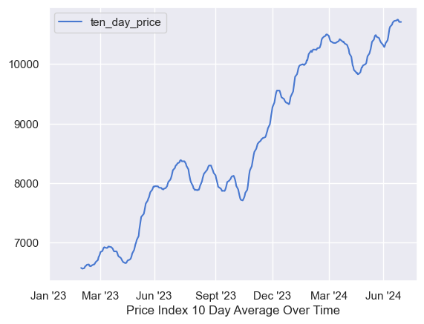
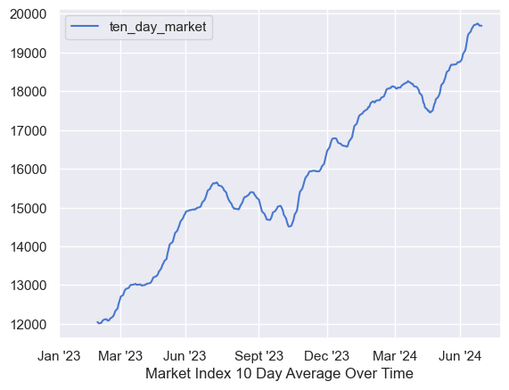
Price Visualization

Slide 19
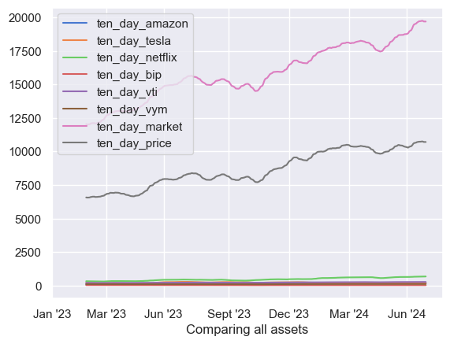
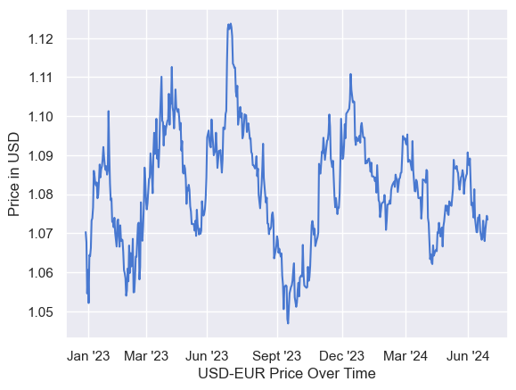
Price Visualization

Slide 20
Price Visualization

Slide 21
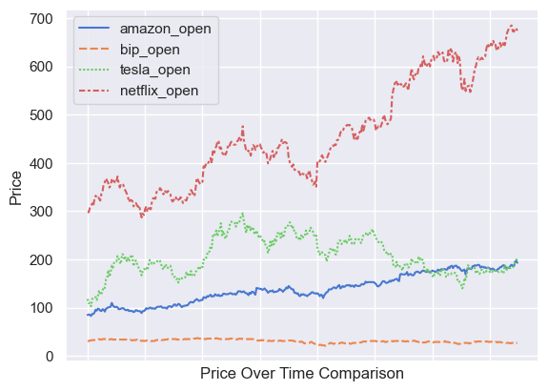
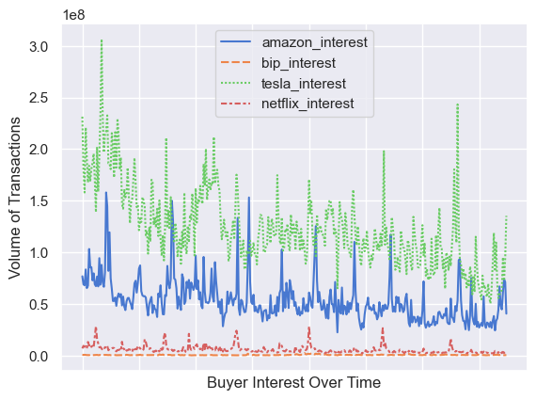
Price Visualization

Slide 22
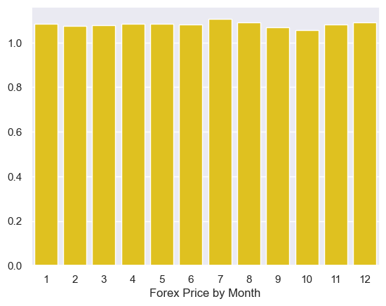
Insights
Forex follows predictable pattern, oscillating with a period of approx. 3 months.
This pattern can be used to buyers’ advantages
The growth is not explosive like stocks, however
Limited effect on price due to month.
July is the high, October the low.

Slide 23
Insights
Note that the dip in Fall 2023 is noticeable in all stocks
Perhaps a reaction to high inflation rates in mid-late 2023
This may have been a good time to buy as all prices were down, and trends repaired quickly for all stocks

Slide 24
Insights
Not a catch-all solution, Tesla experienced a dip and failed to continue growth
Put a modest amount into stocks with proven growth

Slide 25
Summary
HYPOTHETICAL INVESTMENT
A stock’s value being low does not make it a good purchase; look toward beta and sharpe
Forex is predictable; use patterns when making exchanges
If many stocks are experiencing a dip, there’s a possibility it’s a good time to buy
Amazon: 40k
Netflix: 40k
VTI: 10k
Forex: 10k

Slide 26
Sources
[1] https://www.fool.com/investing/2023/01/01/5-top-stocks-for-january/
[2]https://www.kiplinger.com/invested-1000-in-netflix-nflx-stock-worth-how-much-now
[3] https://www.investopedia.com/investing/beta-know-risk/#:~:text=Beta%20is%20a%20concept%20that,a%20stock%20with%20lower%20volatility.
[4] https://www.investopedia.com/ask/answers/010815/what-good-sharpe-ratio.asp#:~:text=The%20Sharpe%20ratio%20can%20be,government%20treasury%20bonds%20or%20bills.

